Slide 1
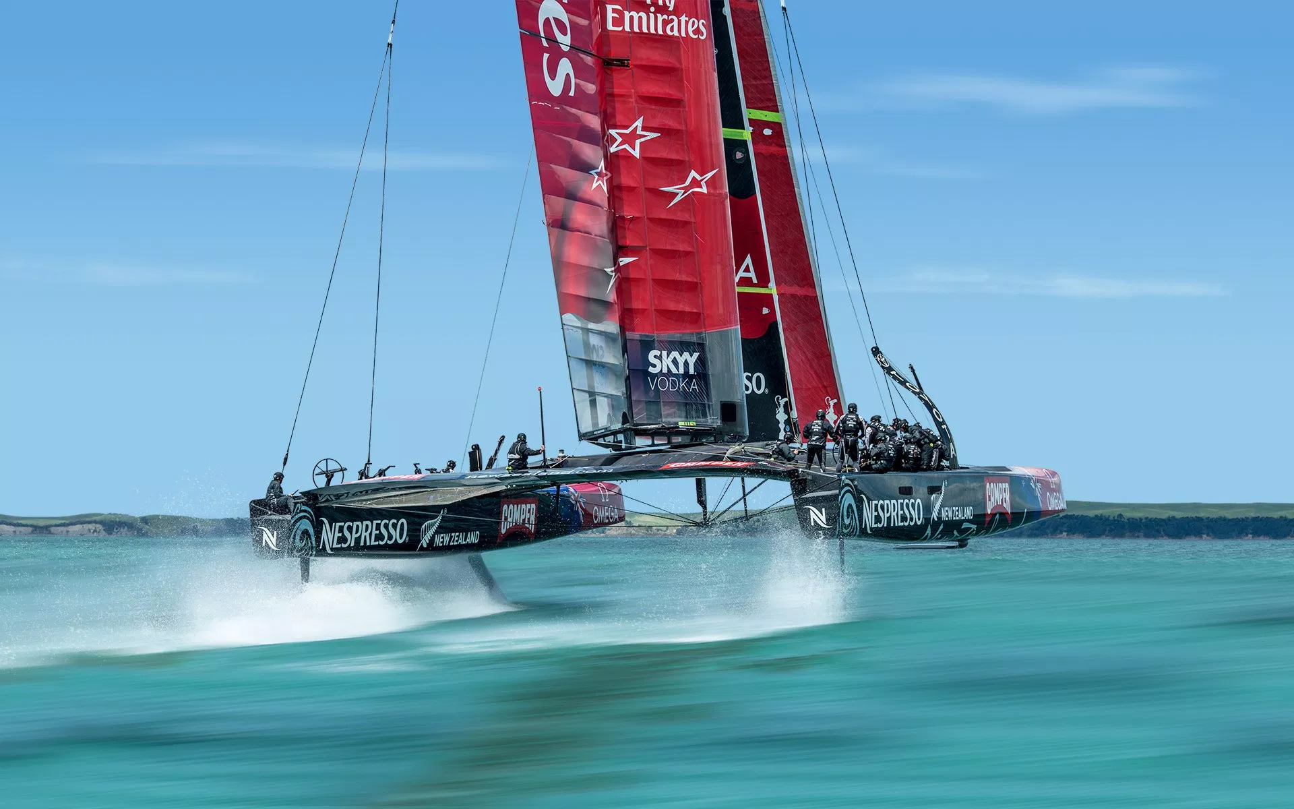
Stream Processing In Sports Sailing
AMERICAS CUP USE CASE
GROUP E: Gianluca Sabbatucci, Alex Kyalo Mutiso, Asier Sarasua Amundarai, Kamal Nandan, Laurens Doedes Breuning Ten Cate, Richard Rohla, Veronique Wang

Slide 2





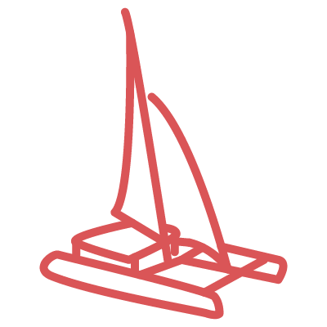
RACE SIMULATION
Finish
The optimal path
Start
Notes:
ROUTE

Slide 3

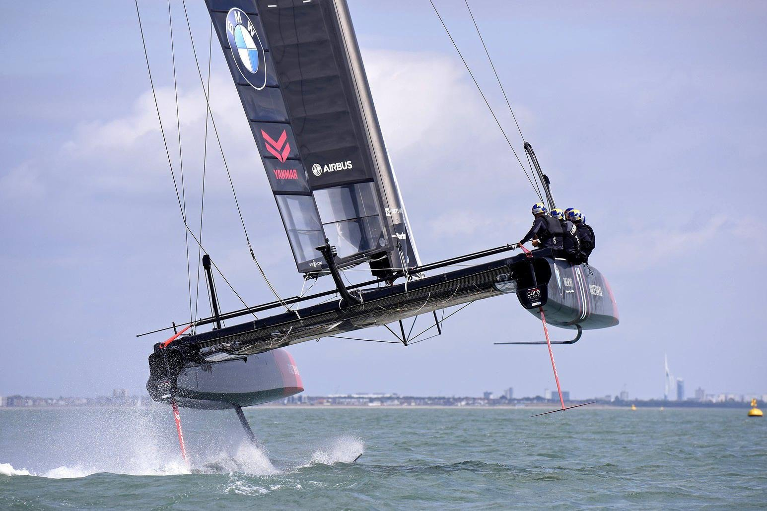




OPTIMAL SUCCESS FACTORS
Data driven navigation in the America’s Cup – The Skippers Aid
Harnessing the power of the wind is the MOST important success factor
Wind Speed
Wind Direction
Wind Acceleration
FYI: The average cost of an Americas cup boat is $10 million and a total investment of up to $100 million
GPS position of readings relative to my location and the finish line
THE BEST TEAM WILL ACHIEVE A BOAT SPEED OF ABOUT 2.2 TIMES THE CURRENT WIND SPEED!!

Slide 4
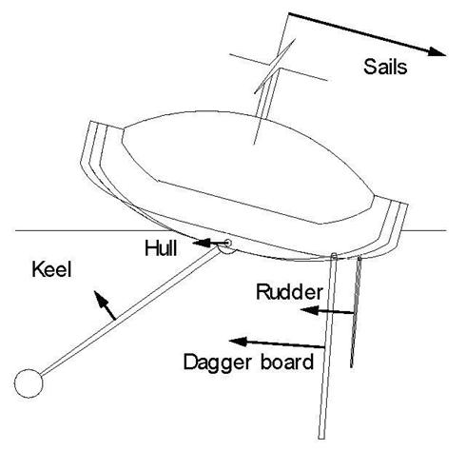


WHY STREAM PROCESSING?
Continuous adjustments to the rudder and dagger board during navigation
Rapid & continuous changes in wind characteristics
Split second decisions
Point a
Point c
Point f
Point k
Finish
boat speed (km/h) | 60 | 70 | 80 | 60 | 70 | 80 | 60 | 70 | 80
distance (meters) | 500 | 500 | 500 | 250 | 250 | 250 | 150 | 150 | 150
time (seconds) | 30 | 26 | 23 | 15 | 13 | 11 | 9 | 8 | 7
Regatta field size (km^2) | 40.96
 | Batch | Stream
Input data | Static | Dynamic
Analysis | Snapshot | Continuous
Response | After job Completion | Immediate
*Remember
Streaming pace is proportional to boat speed
Streaming pace is proportional to regatta field size

Slide 5





OUR ANALYSIS
OUR DATA
Input_Variables
Pressure_0m
Temperature_10m
Winddirection_10m
Winddirection_40m
Windspeed_10m
Windspeed_40m
National Renewable Energy Laboratory
Total size 500 Terabytes
30+ atmospheric variables
7 years at 60 minute resolution
120,000+ gps positions
Output_Variables
Wind Acceleration rate
Wind speed
Optimal boat speed
Recommended GPS points
Wind direction change rate
1 GB slice (Long download)
67,000 + rows
3 gps positions
4 atmospheric elements

Slide 6






SOLUTION ARCHITECTURE
Data sources (Buoys and the Boats)
Stream processing
Database
Onboard display

